Slide 1
BIKE SHARING SYSTEM
BY -
Ishita Arora
Siddhesh Nikam
ITE 5201 Humber College

Slide 2

Problem Statement and Dataset Discussion
Analysis of a system that allows users to borrow bikes for a short time either for free or at a cost
BoomBikes has collected a large dataset on daily bike demand in the American market
The dataset includes information on the demand for shared bikes, based on various parameters
The dataset may include additional factors such as location, time of day, day of the week, and holidays
The analysis and predictions are based on variables including humidity, temperature, windspeed, season, holidays, weathersit, and count (cnt)

Slide 3
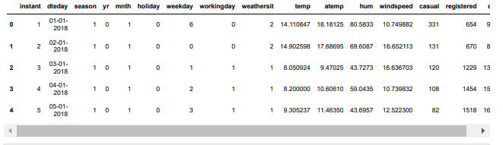
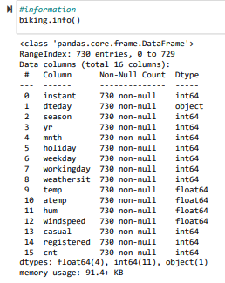
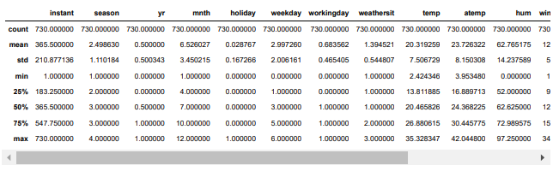

Slide 4
Proposed Analytical/Predictive Model
Dependent variable: client demand; Independent variables: temperature, weather, humidity, and windspeed.
Linear regression model created to forecast demand changes based on these variables.
Data divided into training and testing sets, model trained on training data with Linear Regression() method.
Model's performance evaluated using testing and projected data to demonstrate accuracy in forecasting client demand.

Slide 5
Analysis
We have all columns as float / int type except date type.
There are some fields that are categorical in nature like season, month, holiday , etc.
There are no null values are missing data.
There are no duplicate values.
We will drop columns : Casual and Registered

Slide 6
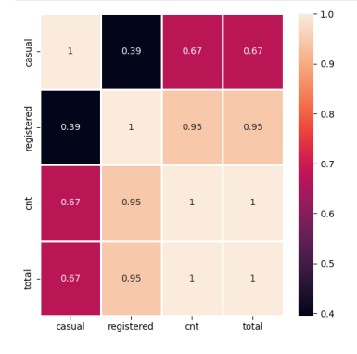
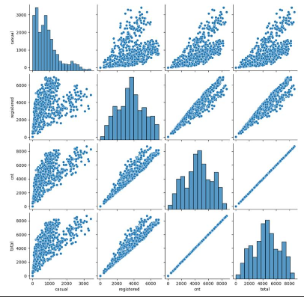
Analysis
As per the analysis we do not require some of the columns instant - record index - which does not have any significance.
temp and attempt are related to each other, so will be using one that is temp.
casual & registered - cnt includes both causal and registered. These columns contains the count of bike booked by different categories of customers. Further, we need to count total number of bikes and not to go with category.
dteday - As we have separate columns for 'year', 'month', so therefore no need of this column.

Slide 7
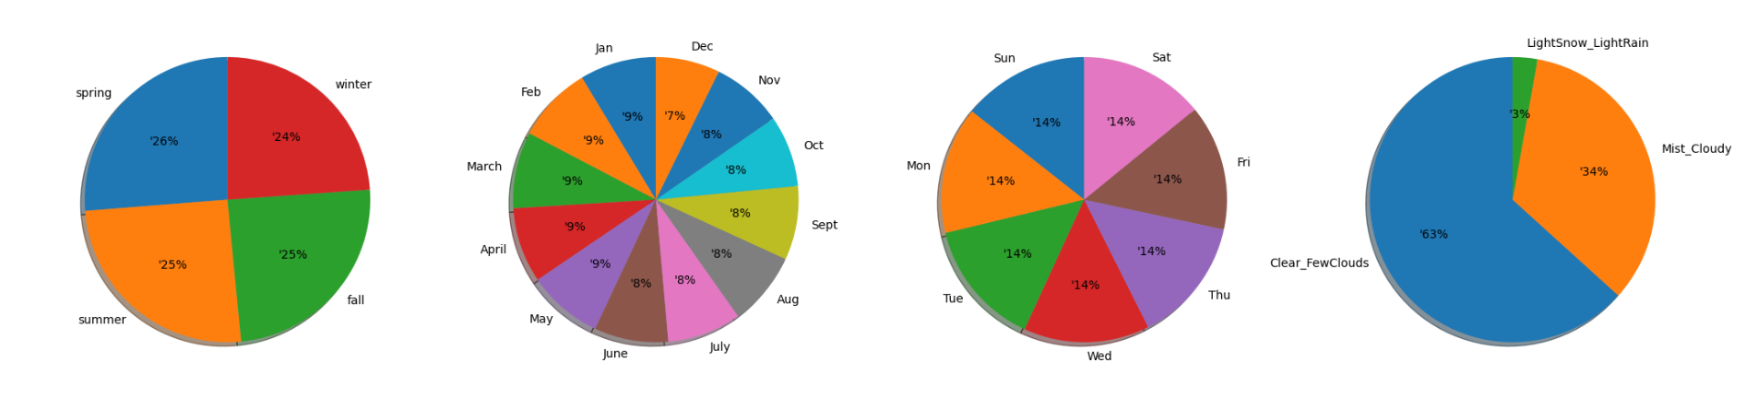
Visualizing the Data
We are differentiating the categorical values and numerical values.
Below categorical columns are having following characteristics and can be mapped with respective values:
Seasons: The business climate is essentially the same across the four seasons.
Monthly: Each monthly % is the same.
Weekdays: There is a similar percentage of business on all weekdays.
Weather: Even though there are four different weather conditions, most individuals prefer to bike when the sky is clear, partially cloudy, or cloudless. The opposite is true when there is heavy rain, ice pallets, a thunderstorm, mist, snow, and fog.

Slide 8
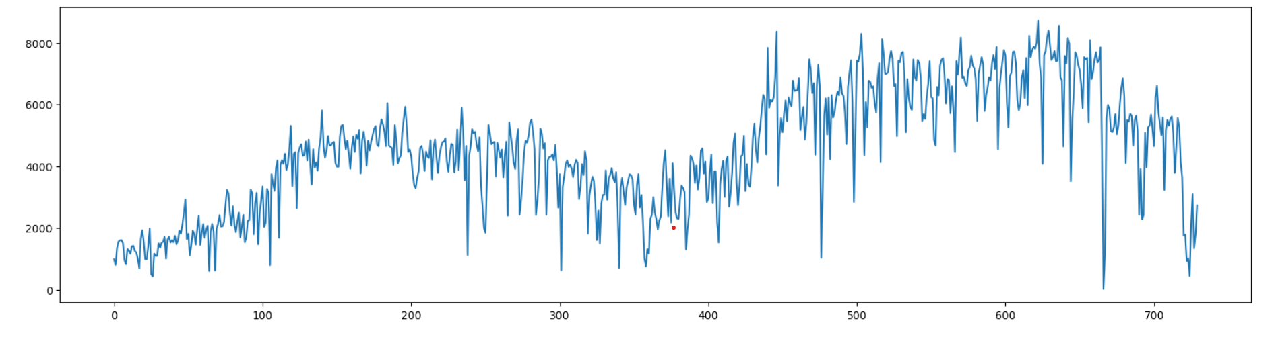
Performing Univariate Analysis
Overtime, there has been a growth, and currently there are comparably few users.

Slide 9
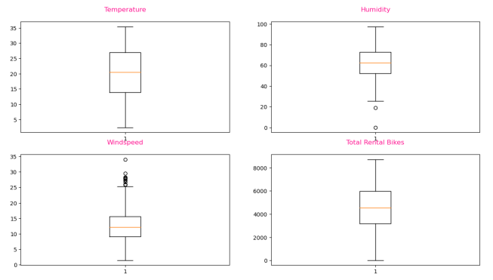
Detecting and treating outliers
Humidity and windspeed have few outlier.
By calculating IQR we can conclude that their percentage is low and insignificant. Therefore, we have removed then using trimming.

Slide 10
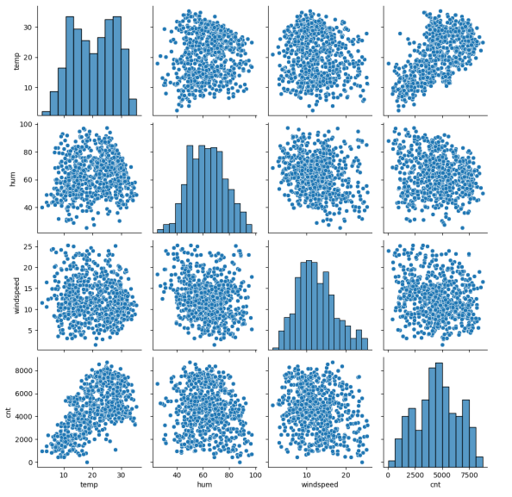
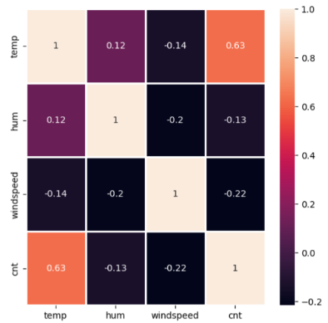
Bivariate Analysis
temp has highest positive correlation with target variable cnt.

Slide 11
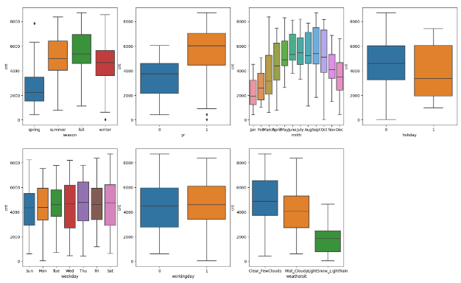
According to season, in summer & fall most people rent the bicycles.
According to month, most bookings are happening between May to October.
According to weather, when the sky is clear, most bookings were done.
Bookings were happening on all days of the week.
During non-holiday hours, bicycle rentals were more.

Slide 12

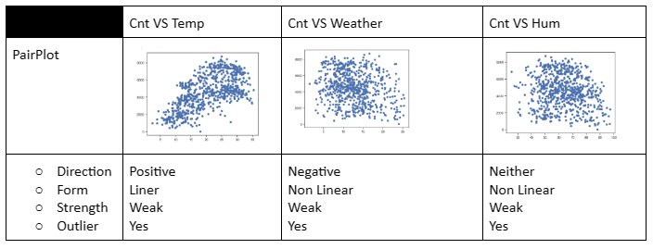



Problem Statement and Dataset Discussion​
To analyze the dataset, we utilized pairplots for examining both univariate and bivariate relationships, as well as heatmaps to identify correlation coefficients.
By examining the data, we can determine, for example, that shared bike demand is higher on weekdays compared to weekends, or that poor weather conditions lead to a decrease in demand.​

Slide 13
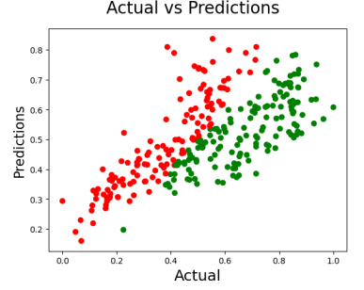
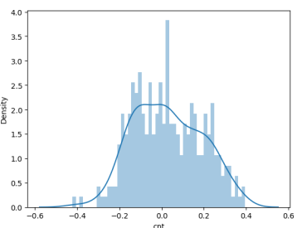

Model evaluation
RMSE (Root Mean Squared Error): measure the overall performance of a regression model.
MAE (Mean Absolute Error): the average absolute difference between the predicted values and the actual values. MSE (Mean Squared Error): the average of the squared differences between the predicted values and the actual values

Slide 14
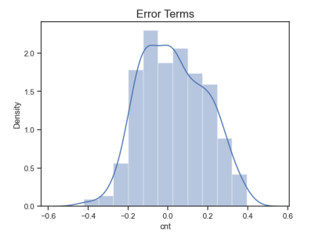
Residual Analysis
The distribution plot of error term show the normal distribution of mean at zero.

Slide 15

Results and Discussion
The graph shows that the actual and predicted values are closely aligned, with only a few inaccuracies in the predictions. This suggests that our model is capable of providing accurate predictions.

Slide 16

Thank You

